Slide 1
Biology 101 Animal Diversity
SECTION 2
DR. ANNAD
APRIL 12, 2017

Slide 2
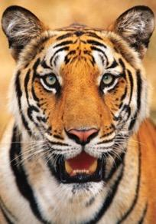
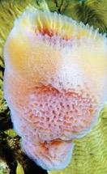
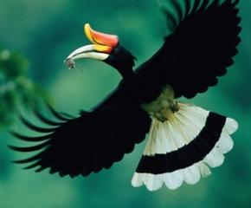
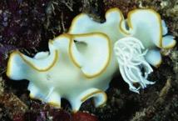
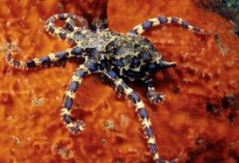
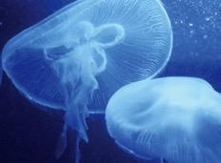
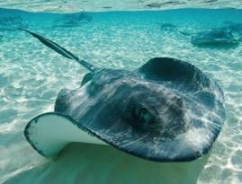
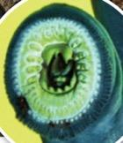
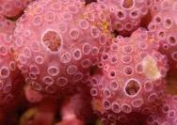
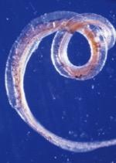
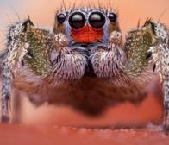
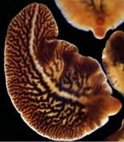
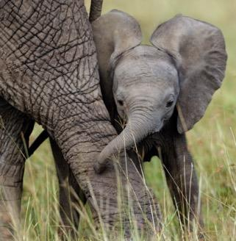
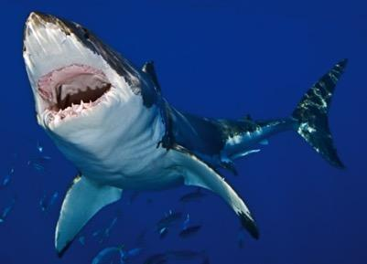
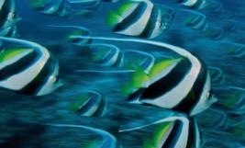
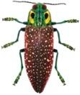
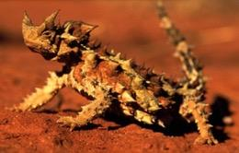
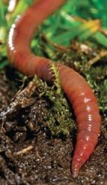
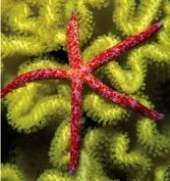
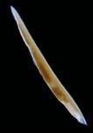
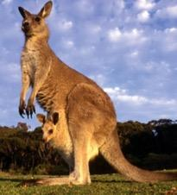
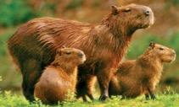
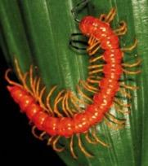
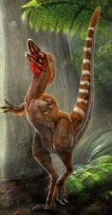
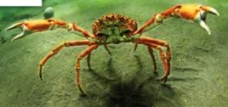
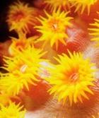
Animal Diversity
All images from Phelan, What is Life? 3rd Ed.
Notes:
Variety of habitats, body plans, complexity, life cycle stages, etc.
Distribution of this variety is one area that biologists use to evaluate evolutionary history

Slide 3
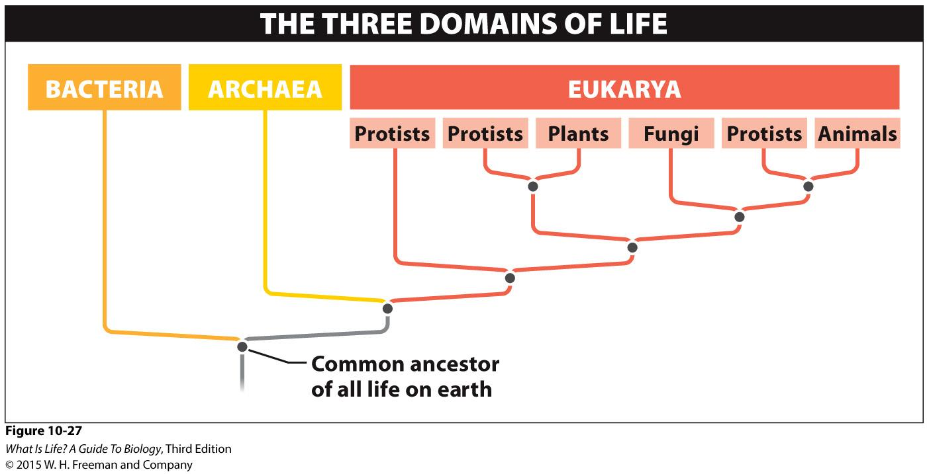
Domains of Life

Slide 4
Microbial Diversity

Slide 5
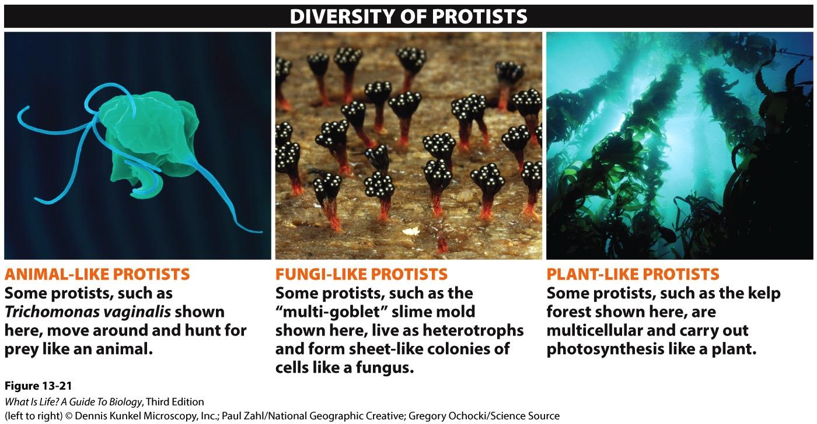
Protists

Slide 6
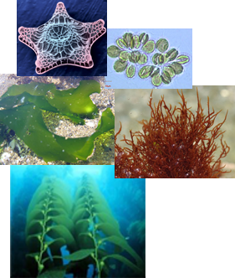
Algae
Photosynthetic, but not plants
Grow only in water
Diverse group: single-cell diatoms to large giant kelp
Green algae most similar to plants
Notes:
Algae has the capability of photosynthesis but it is NOT a plant! A test question will ask what plant like organism can utilize photosynthesis but is not botanically a plant.

Slide 7
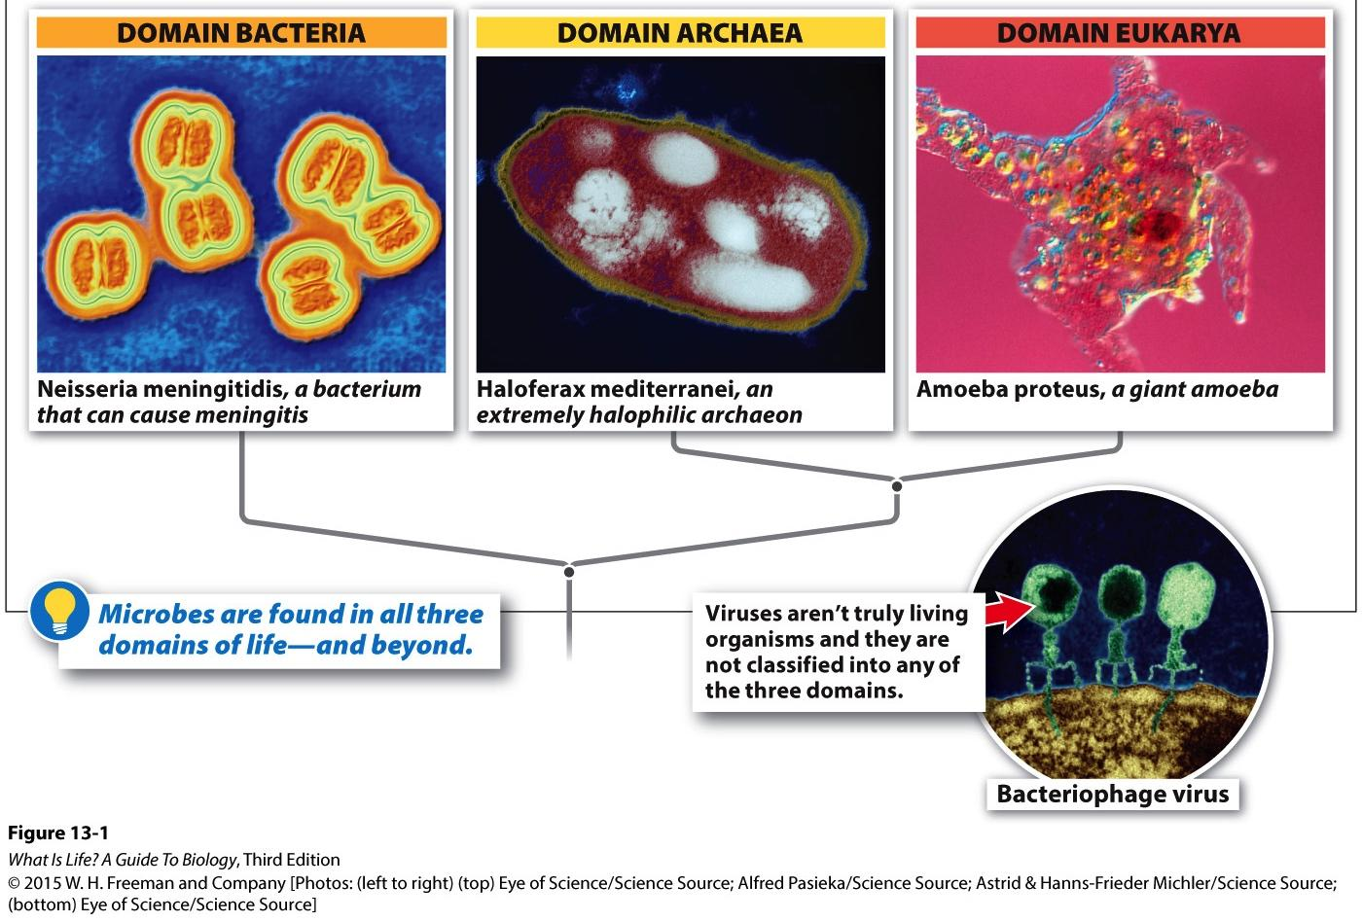
Microbes
Found in all domains of life
Characterized by mostly single-celled organisms
All bacteria & archaea
Some (but not all) protists

Slide 8
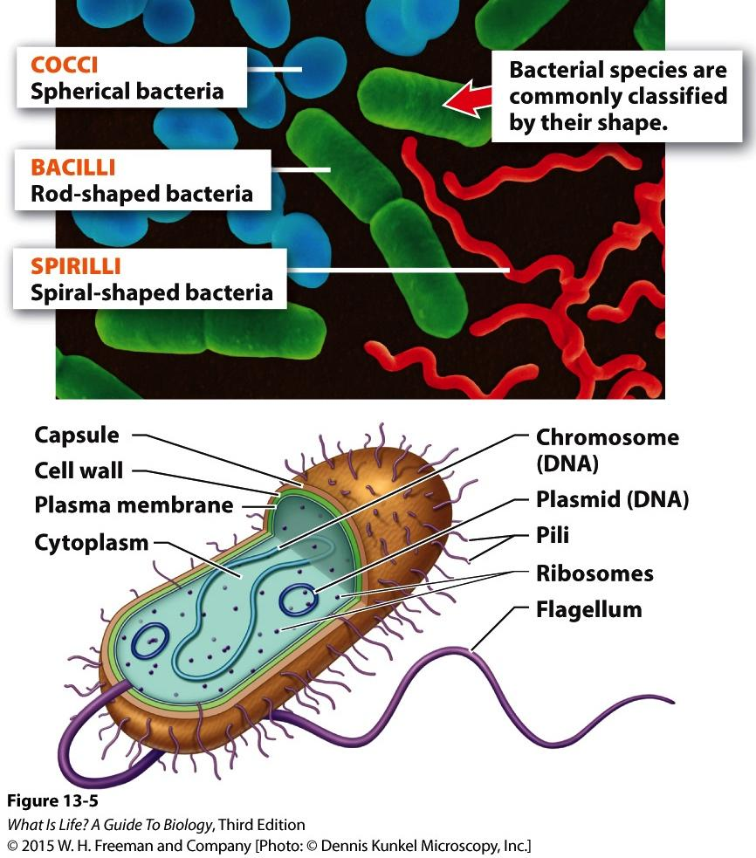
Bacteria
All bacteria are unicellular prokaryotes
Traditionally classified by physical characteristics & various lab tests
Ability to survive on different types of media
Staining patterns using different types of staining agents
Ability to compare DNA sequences major advance in understanding bacterial diversity
Notes:
Few physical characteristics or observable traits make classification difficult
Very few bacteria can actually be cultured in the lab

Slide 9
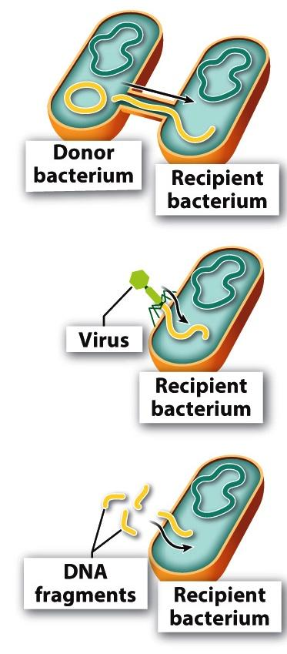
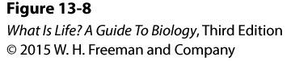
Horizontal Gene Transfer
Special means of exchanging genetic material between bacteria
Particular environmental conditions & special characteristics necessary, i.e., doesn’t always happen
Three methods:
Conjugation = Direct transfer between two bacteria using a special structure
Transduction = Transfer via a virus
Transformation = Fragments of DNA in the environment are taken up by a bacterium

Slide 10
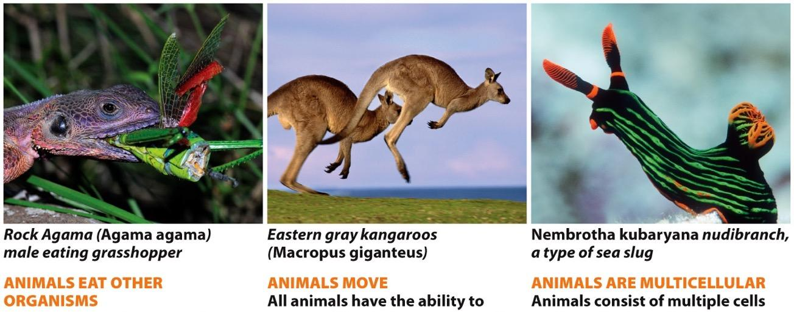
Key Traits of Animals
Multicellular
Capable of moving during at least some phase
Energy from other organisms
Notes:
Animals themselves do not photosynthesize, but may be symbionts with other organisms that do photosynthesize, e.g., corals

Slide 11
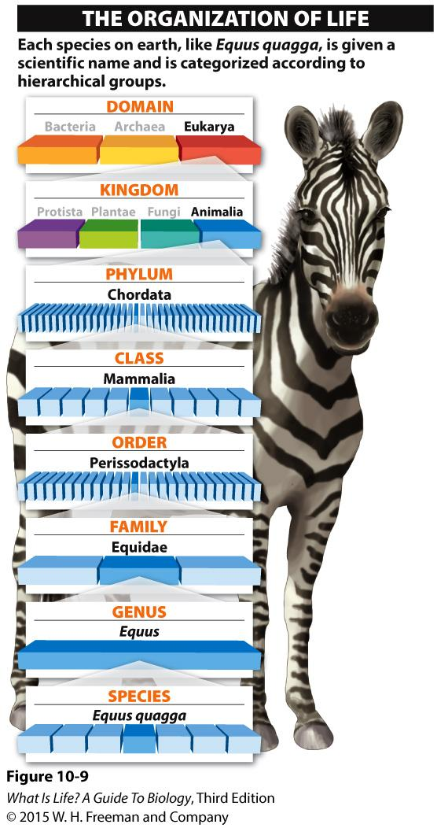
Classification of Life
Each group is called a taxon (plural = taxa)
Hierarchal grouping of organisms based on shared traits
Goal is to use traits with common origin

Slide 12
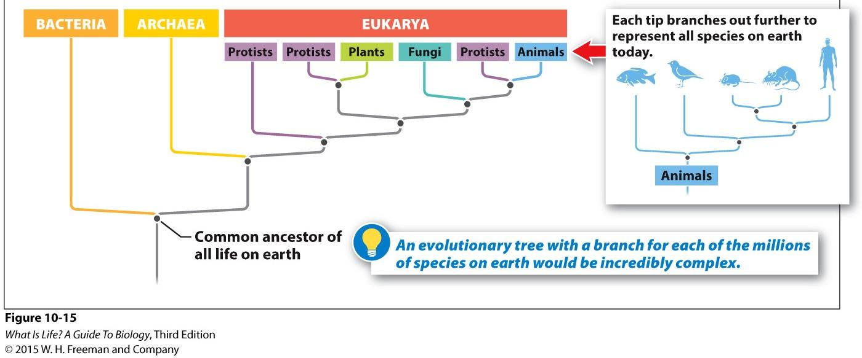
Phylogenetic trees
Phylogenetic tree: Tool for organizing information about biodiversity
Hypotheses regarding the evolutionary relationships between species
Traits: Features of organisms that scientists use to evaluate how different organisms are related
Before ability to analyze DNA, morphological (physical) traits
Most modern trees incorporate DNA analysis in multiple ways
Often compiled into tables comparing traits
Notes:
As new evidence is collected, phylogenetic trees are modified to incorporate this new information

Slide 13
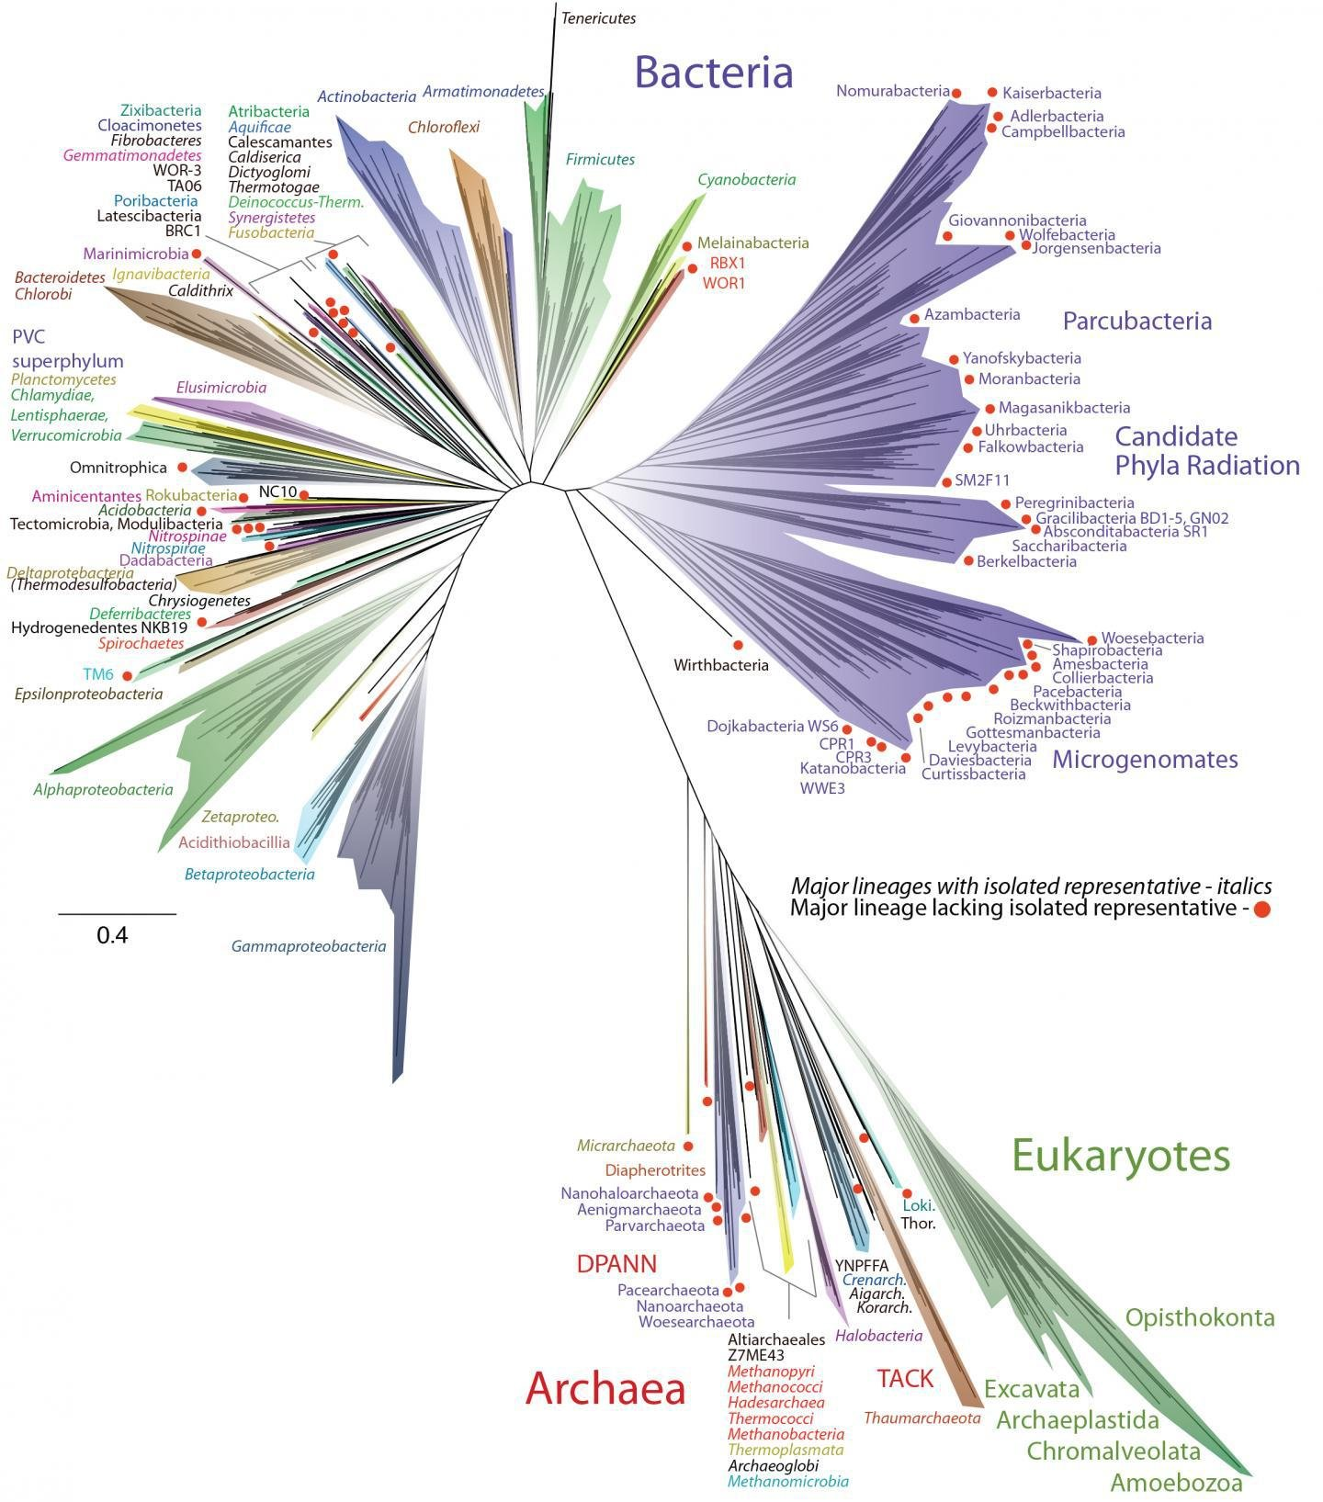
Source: Hug, L. A., et al. (2016). Nature Microbiol. doi:10.1038/nmicrobiol.2016.48.

Slide 14
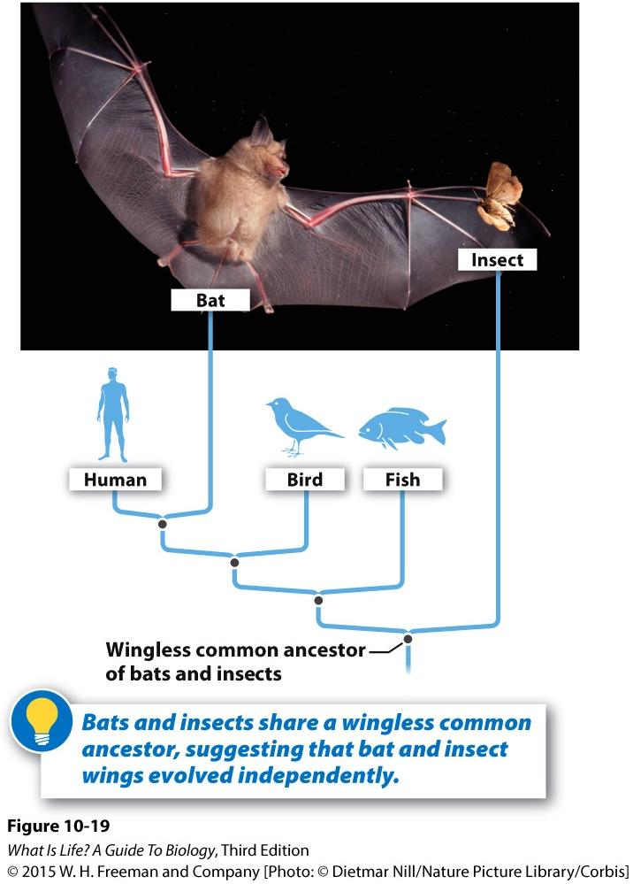
Trait Origin
Want to group organisms based on traits with a shared origin
e.g., similar bones in forelimbs of all mammals
Avoid grouping based on traits showing a similar form, but different origin

Slide 15
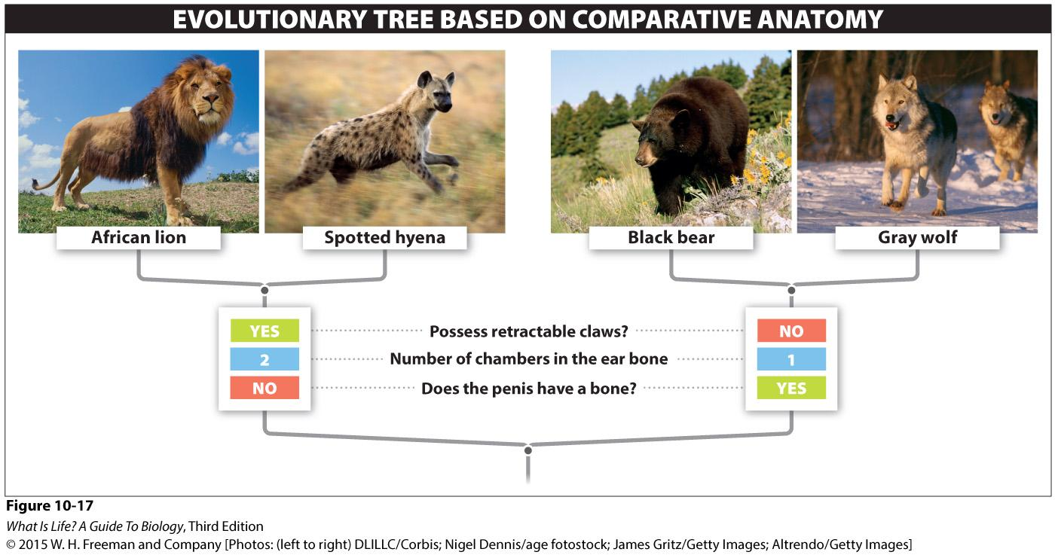
Interpreting Trees
Tips may represent any level
Move back in time as move from tip to root
Nodes can be rotated without changing relationships

Slide 16
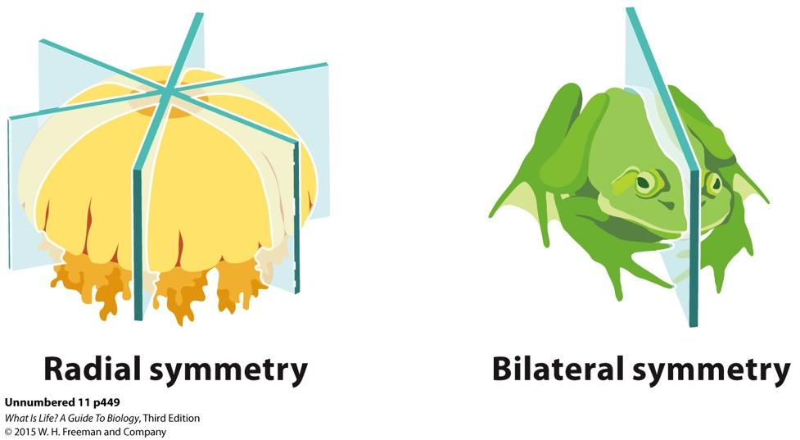
Symmetry
Asymmetry means that there’s no discernable “top”, “bottom”, “front”, or “back”
Radial symmetry generally means the organism has some sort of circular plan, but does have a “top” & “bottom”
Bilateral symmetry adds the ability to determine “left” & “right”, and usually “front” & “back”

Slide 17
Animal Diversity Trends
TRAIT |  | TREND OVER EVOLUTIONARY TIME
Key Distinctions | Tissues | None → Multiple types
 | Symmetry | None → Radial → Bilateral/Radial → Bilateral
 | Gut Development | None → Front to Back (Protostomes) → Back to Front (Deuterostomes)
 | Growth Pattern | (Protostomes only) Molting → Continuous
Reproductive Mode | Asexual/sexual | Asexual → Sexual
 | Reproduction requires water | Mandatory → Unnecessary
 | Fertilization | External → Internal
 | Location of Development | External → External Egg → Internal
 | Number of Offspring | Large → Small
 | Parental Investment | Small → Large
Notes:
The trends for the key distinctions are the important trends to know & understand how to map on the animal tree for the exam
Don’t need to know how to map the reproductive mode trends onto the tree (it’s complex), but DO need to understand the trends
Think about the implications of these trends, e.g., is it possible for an organism for whom water is mandatory for reproduction to live in a desert? What about an organism with internal development, can they have a small amount of parental investment? What advantages might each option provide? What disadvantages?

Slide 18
Evolution
The process by which different kinds of living organisms are thought to have developed and diversified from earlier forms during the history of the earth.
Change in allele frequencies over time

Slide 19
Evidence from Multiple Sources
Fossils
Species distributions (biogeography)
Comparative anatomy & embryology
Molecular biology
Experiments

Slide 20
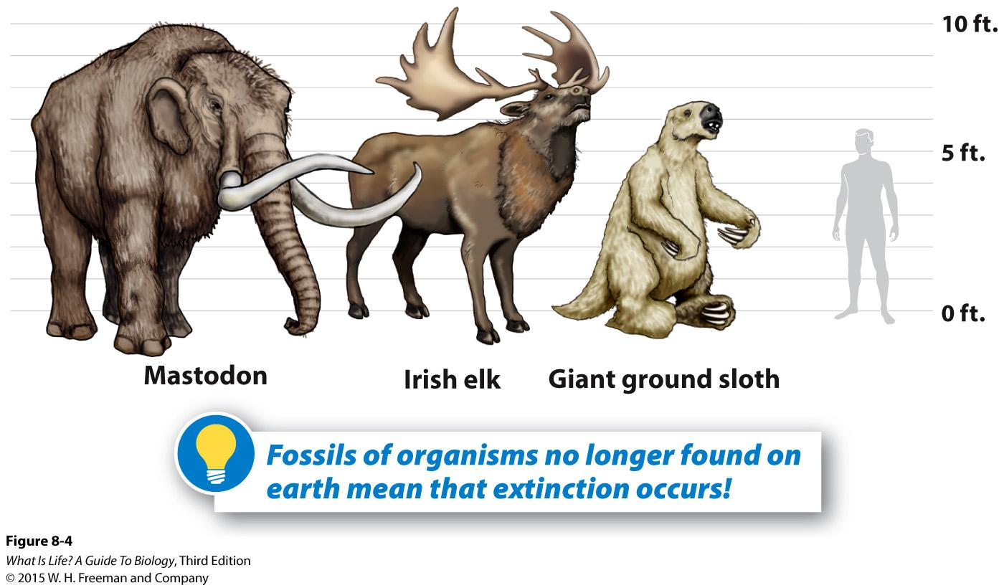
Fossils

Slide 21
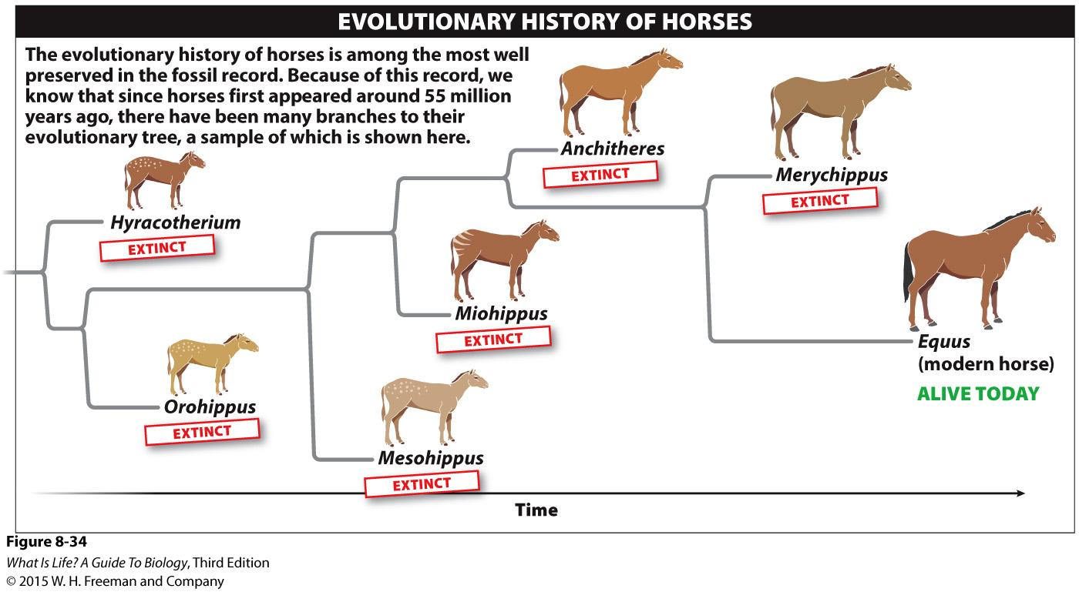
Fossil Progressions

Slide 22
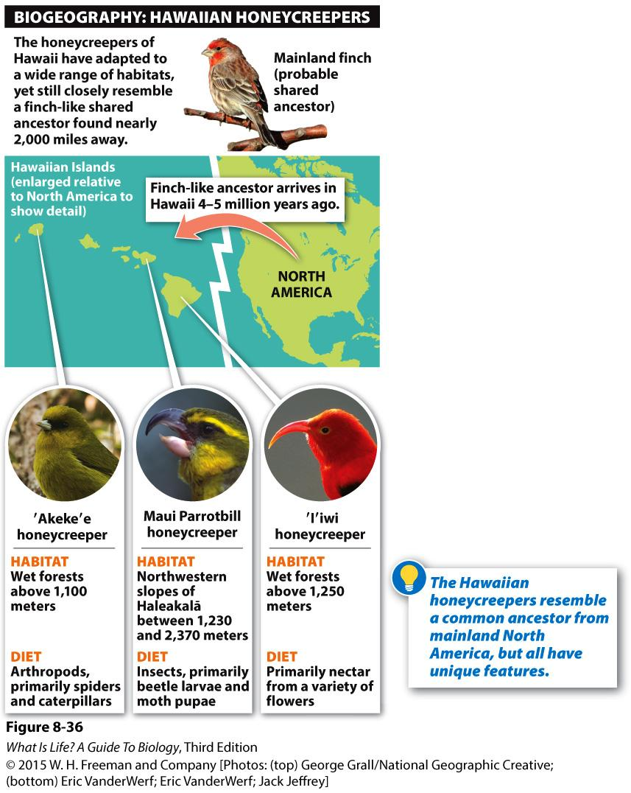
Relationships Between Species

Slide 23
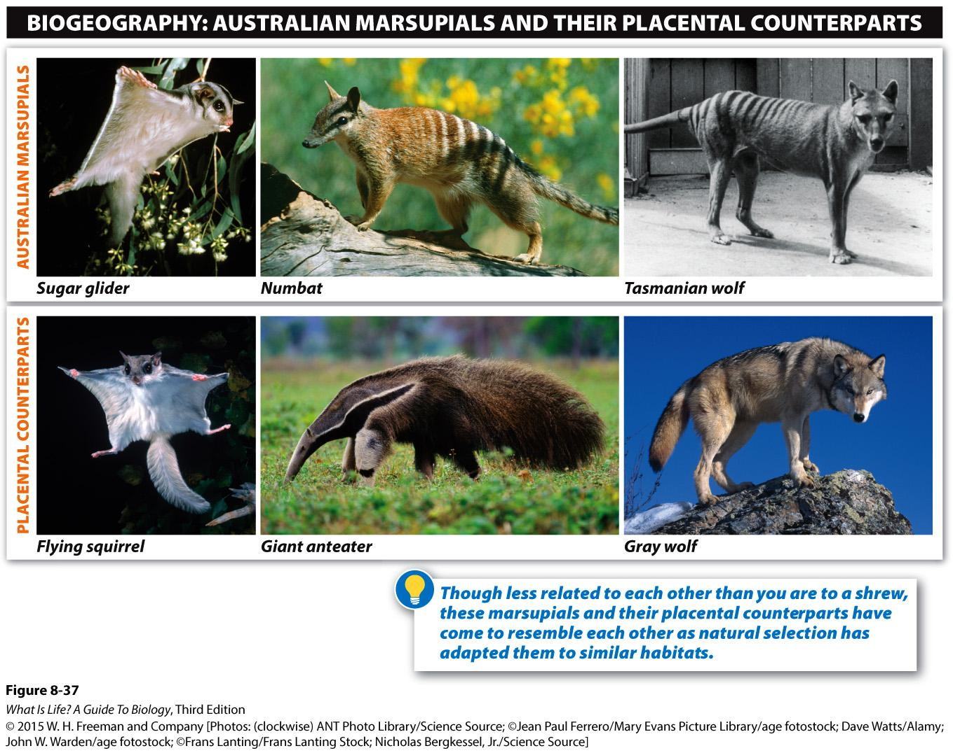
Similar Ecological Roles

Slide 24
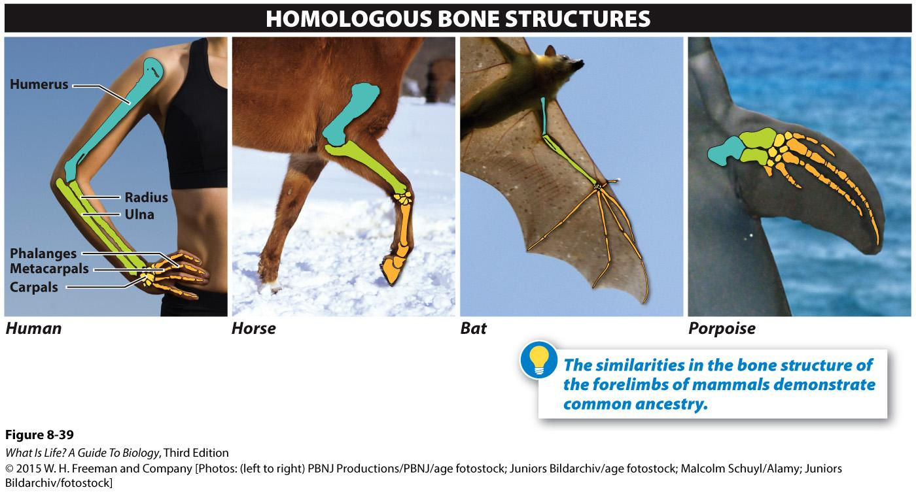
Comparative Anatomy

Slide 25
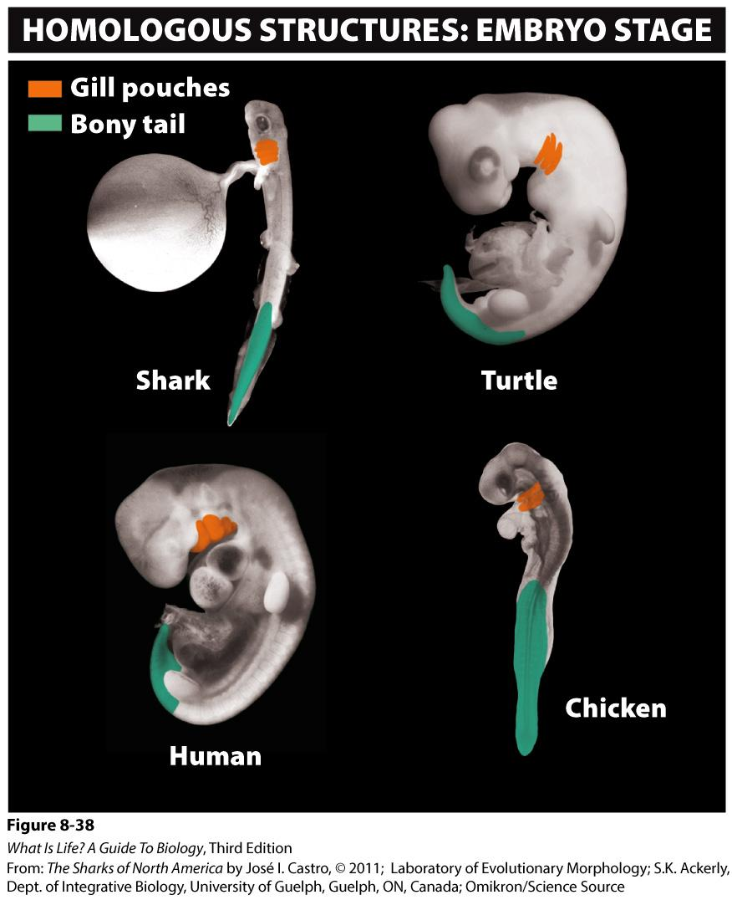
Comparative Embryology

Slide 26
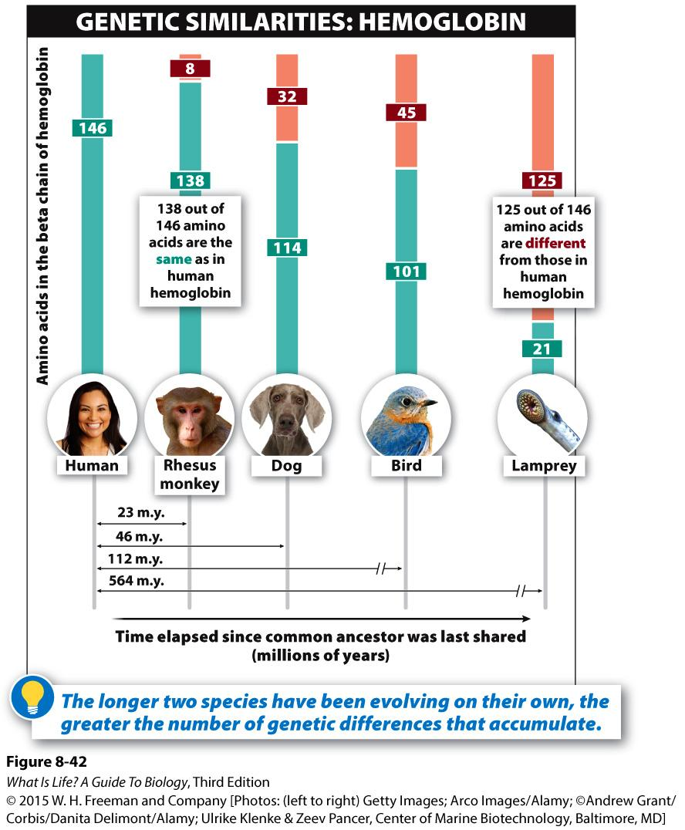
Molecular Biology
Similarities in DNA, proteins, cellular processes & molecular structures
Time since divergence from common ancestor has relationship with similarities

Slide 27
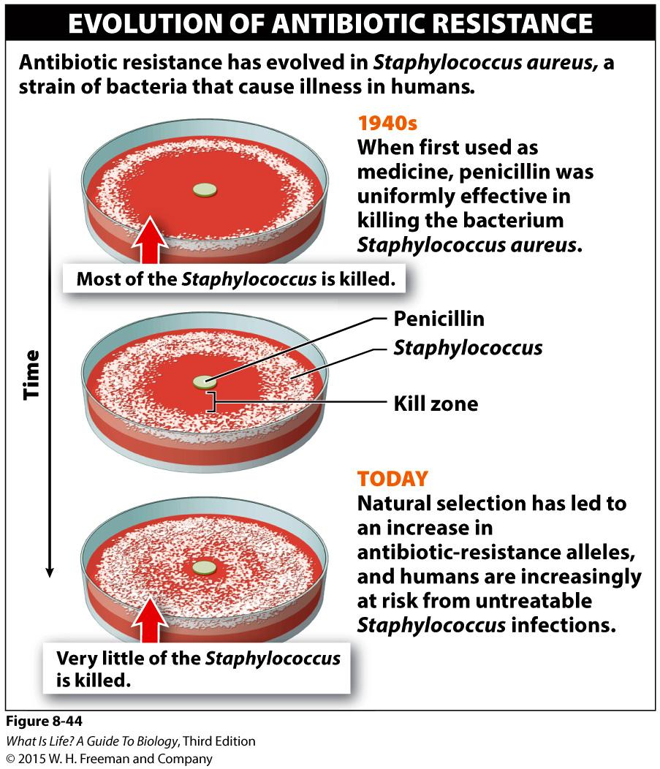
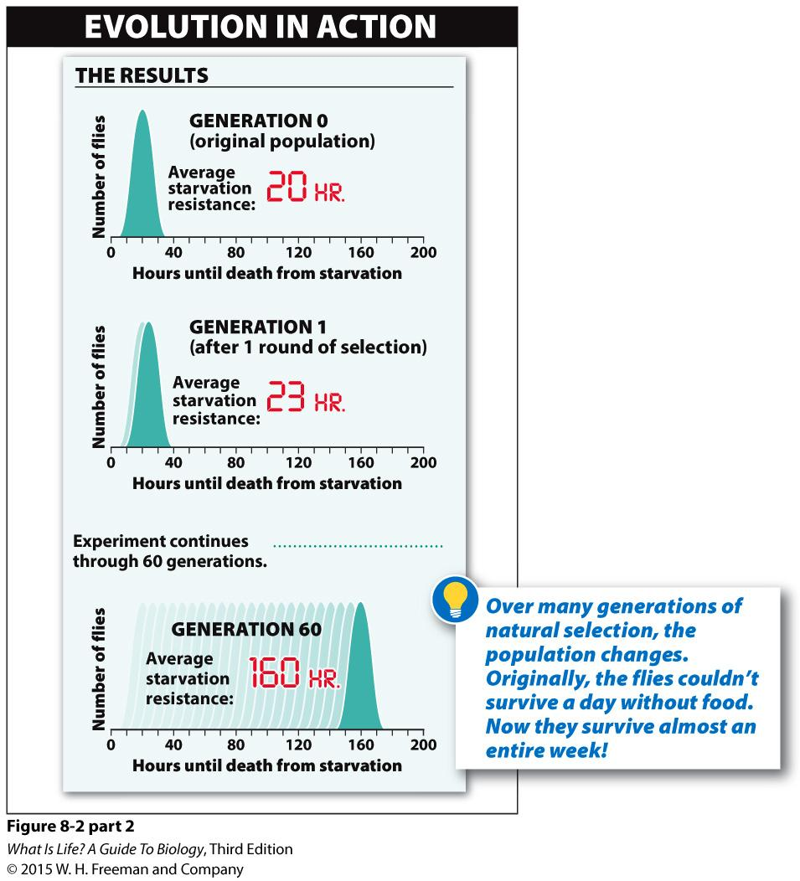
Evolution Experiments
Notes:
Changes in allele frequencies are especially detectable in populations that have short generation times, so MANY generations occur in time frames that are observable to humans
Bacteria, plants, insects, rodents, etc.

